Slide 1
AGILE METHODOLOGY
-BY VISHALI S

Slide 2
Definition:
Agile testing is a software testing process that follows the principles of agile software development. Agile testing methodology aligns with iterative development methodology in which requirements develop gradually from customers and testing teams. The development is aligned with customer requirements.
Agile testing process is a continuous process rather than being sequential. The testing begins at the start of the project and there is ongoing integration between testing and development. The common objective of agile development and testing is to achieve a high product quality.

Slide 3
Agile Testing Principles:
Testing is continuous: Agile team tests continuously because it is the only way to ensure continuous progress of the product.
Continuous feedback- Agile testing provides feedback on an ongoing basis and this is how your product meets the business needs.
Tests performed by the whole team: In a traditional software development life cycle, only the test team is responsible for testing but in agile testing, the developers and the business analysts also test the application.
Decrease time of feedback response: The business team is involved in each iteration in agile testing & continuous feedback shortens the time of feedback response.
Simplified & clean code: All the defects which are raised by the agile team are fixed within the same iteration and it helps in keeping the code clean and simplified.
Less documentation: Agile teams use a reusable checklist, the team focuses on the test instead of the incidental details.
Test Driven: In agile methods, testing is performed at the time of implementation whereas, in the traditional process, the testing is performed after implementation.

Slide 4
Agile Testing Methods:
Behavior Driven Development (BDD).
Acceptance Test Driven Development (ATDD).
Exploratory Testing.

Slide 5
Behavior Driven Development (BDD):
Behavior Driven Development (BDD) improves communication amongst project stakeholders so that all members correctly understand each feature before the development process starts. There is continuous example-based communication between developers, testers, and business analysts.
The examples are called Scenarios which are written in a special format called Gherkin Given/When/Then syntax. The scenarios hold information on how a given feature should behave in different situations with different input parameters. These are called “Executable Specifications” as it comprises of both specification and inputs to the automated tests.

Slide 6
Acceptance Test Driven Development (ATDD):
ATDD focuses on involving team members with different perspectives such as the customer, developer, and tester. Three Amigos meetings are held to formulate acceptance tests incorporating perspectives of the customer, development, and testing. The customer is focused on the problem that is to be solved, the development is focused on how the problem will be solved whereas the testing is focused on what could go wrong. The acceptance tests are a representation of the user’s point of view and it describes how the system will function. It also helps to verify that the system functions as it is supposed to. In some instances acceptance tests are automated.

Slide 7
Exploratory Testing:
In this type of testing, the test design and test execution phase go hand in hand. Exploratory testing emphasizes working software over comprehensive documentation. The individuals and interactions are more important than the process and tools. Customer collaboration holds greater value than contract negotiation. Exploratory testing is more adaptable to changes. In this testers identify the functionality of an application by exploring the application. The testers try to learn the application, and design & execute the test plans according to their findings.

Slide 8
Agile Testing Life Cycle:
Impact assessment
Agile Testing Planning
Release Readiness
Daily Scrums
Test Agility Review

Slide 9
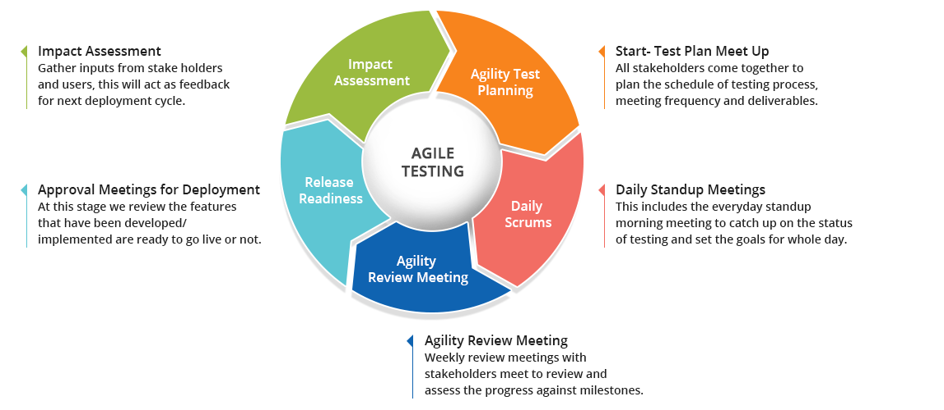
Diagram:

Slide 10
Advantages of Agile Testing Methodology:
It saves time and money.
It is flexible and highly adaptable to changes.
It provides a way for receiving regular feedback from the end user.
Better determination of issues through daily meetings.

Slide 11
Disadvantages of Agile Testing Methodology:
Lack of documentation.
Scope creep.
High demands on time.
Unsuitable for long-term projects.

Slide 12
Conclusion:
Agile testing not only facilitates the early detection of defects but also reduces the cost of bugs by fixing them early. This approach also yields a customer-centric approach by delivering a high-quality product as early as possible.

Slide 13


